Slide 1



Customer aggregate report

Slide 2
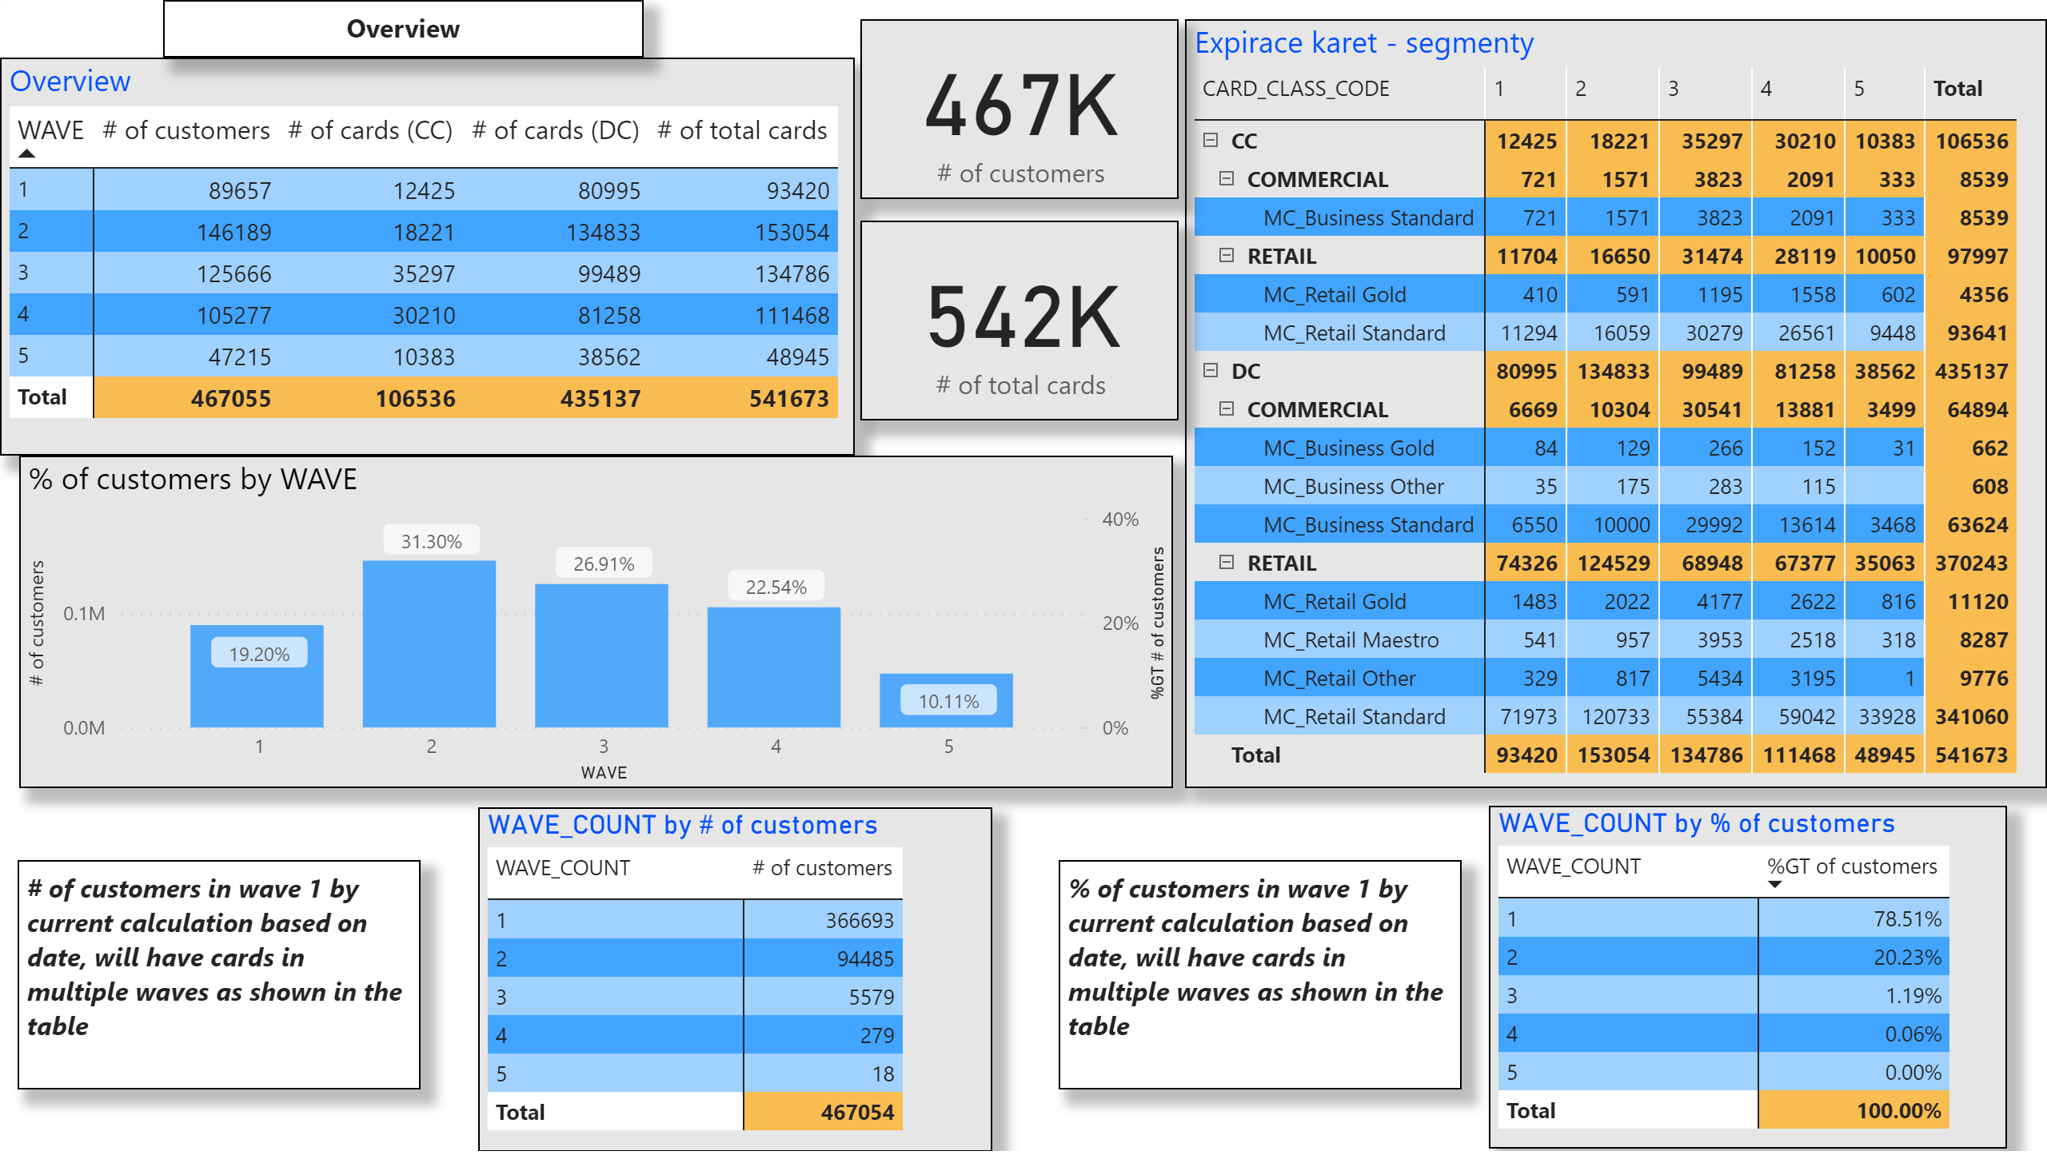
Overview1
Notes:
textbox
No alt text provided.
textbox
No alt text provided.
Overview
No alt text provided.
% of customers by WAVE
No alt text provided.
Expirace karet - segmenty
No alt text provided.
card
No alt text provided.
WAVE_COUNT by # of customers
No alt text provided.
WAVE_COUNT by % of customers
No alt text provided.
card
No alt text provided.
textbox
No alt text provided.

Slide 3
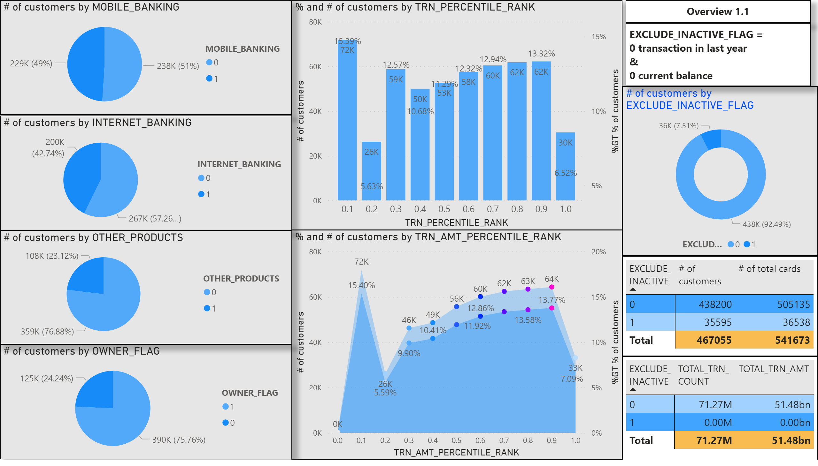
Overview1.1
Notes:
# of customers by EXCLUDE_INACTIVE_FLAG
No alt text provided.
pivotTable
No alt text provided.
pivotTable
No alt text provided.
textbox
No alt text provided.
textbox
No alt text provided.
% and # of customers by TRN_PERCENTILE_RANK
No alt text provided.
% and # of customers by TRN_AMT_PERCENTILE_RANK
No alt text provided.
pieChart
No alt text provided.
pieChart
No alt text provided.
pieChart
No alt text provided.
pieChart
No alt text provided.

Slide 4
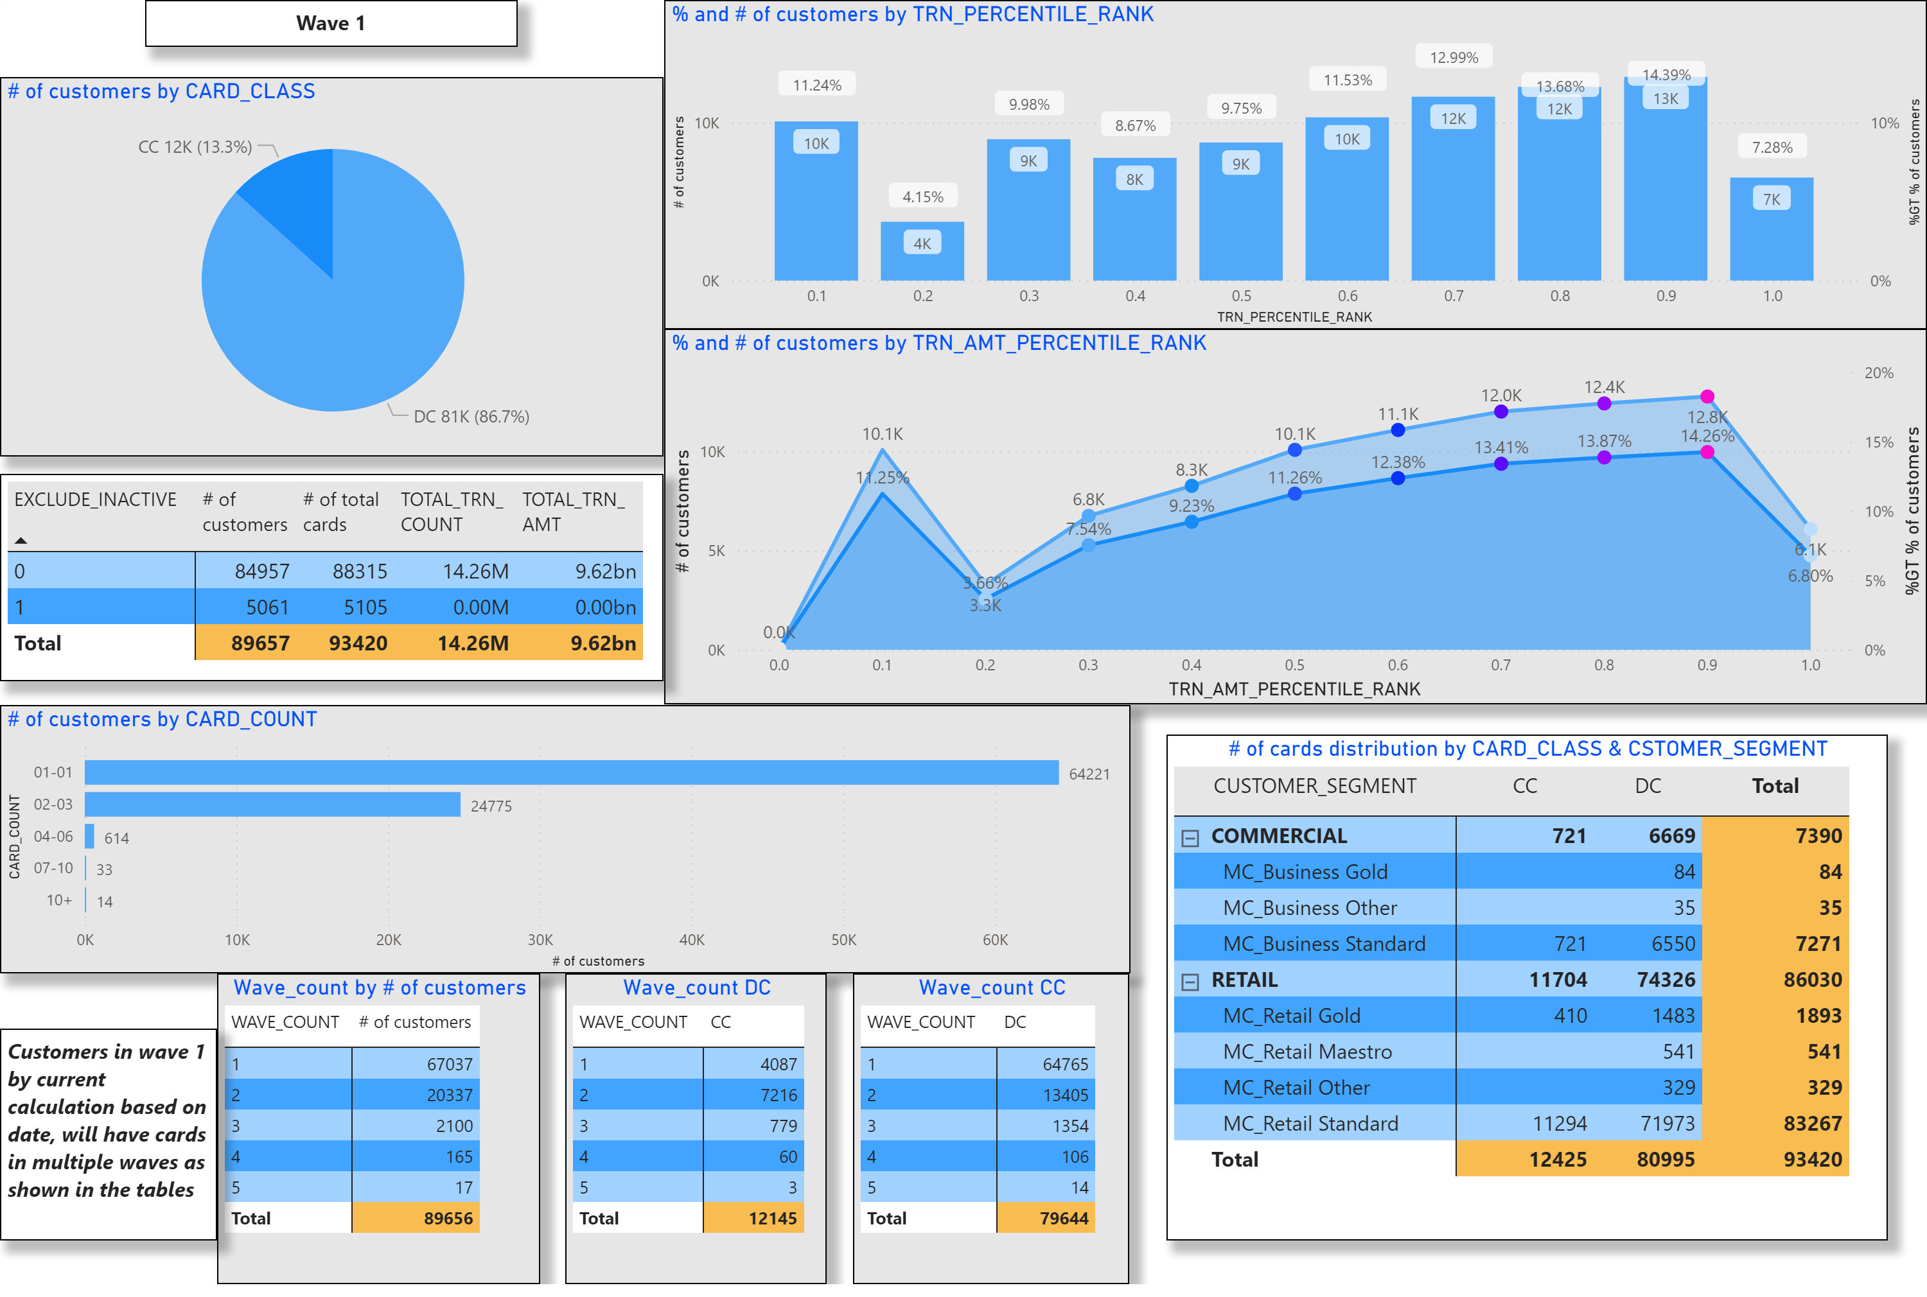
Wave 1
Notes:
textbox
No alt text provided.
# of customers by CARD_CLASS
No alt text provided.
% and # of customers by TRN_PERCENTILE_RANK
No alt text provided.
% and # of customers by TRN_AMT_PERCENTILE_RANK
No alt text provided.
clusteredBarChart
No alt text provided.
# of cards distribution by CARD_CLASS & CSTOMER_SEGMENT
No alt text provided.
pivotTable
No alt text provided.
Wave_count DC
No alt text provided.
Wave_count CC
No alt text provided.
Wave_count by # of customers
No alt text provided.
textbox
No alt text provided.

Slide 5
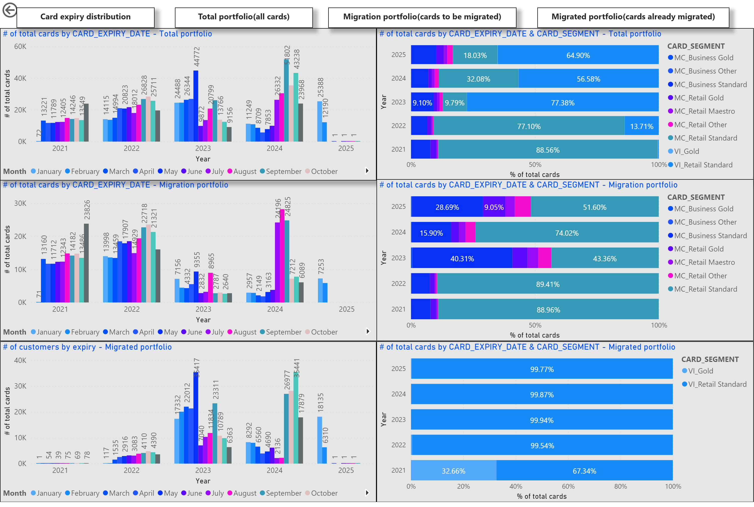
Card expiry
Notes:
textbox
No alt text provided.
textbox
No alt text provided.
textbox
No alt text provided.
textbox
No alt text provided.
actionButton
No alt text provided.
# of total cards by CARD_EXPIRY_DATE - Migration portfolio
No alt text provided.
# of customers by expiry - Migrated portfolio
No alt text provided.
# of total cards by CARD_EXPIRY_DATE - Total portfolio
No alt text provided.
# of total cards by CARD_EXPIRY_DATE & CARD_SEGMENT - Total portfolio
No alt text provided.
# of total cards by CARD_EXPIRY_DATE & CARD_SEGMENT - Migration portfolio
No alt text provided.
# of total cards by CARD_EXPIRY_DATE & CARD_SEGMENT - Migrated portfolio
No alt text provided.

Slide 6
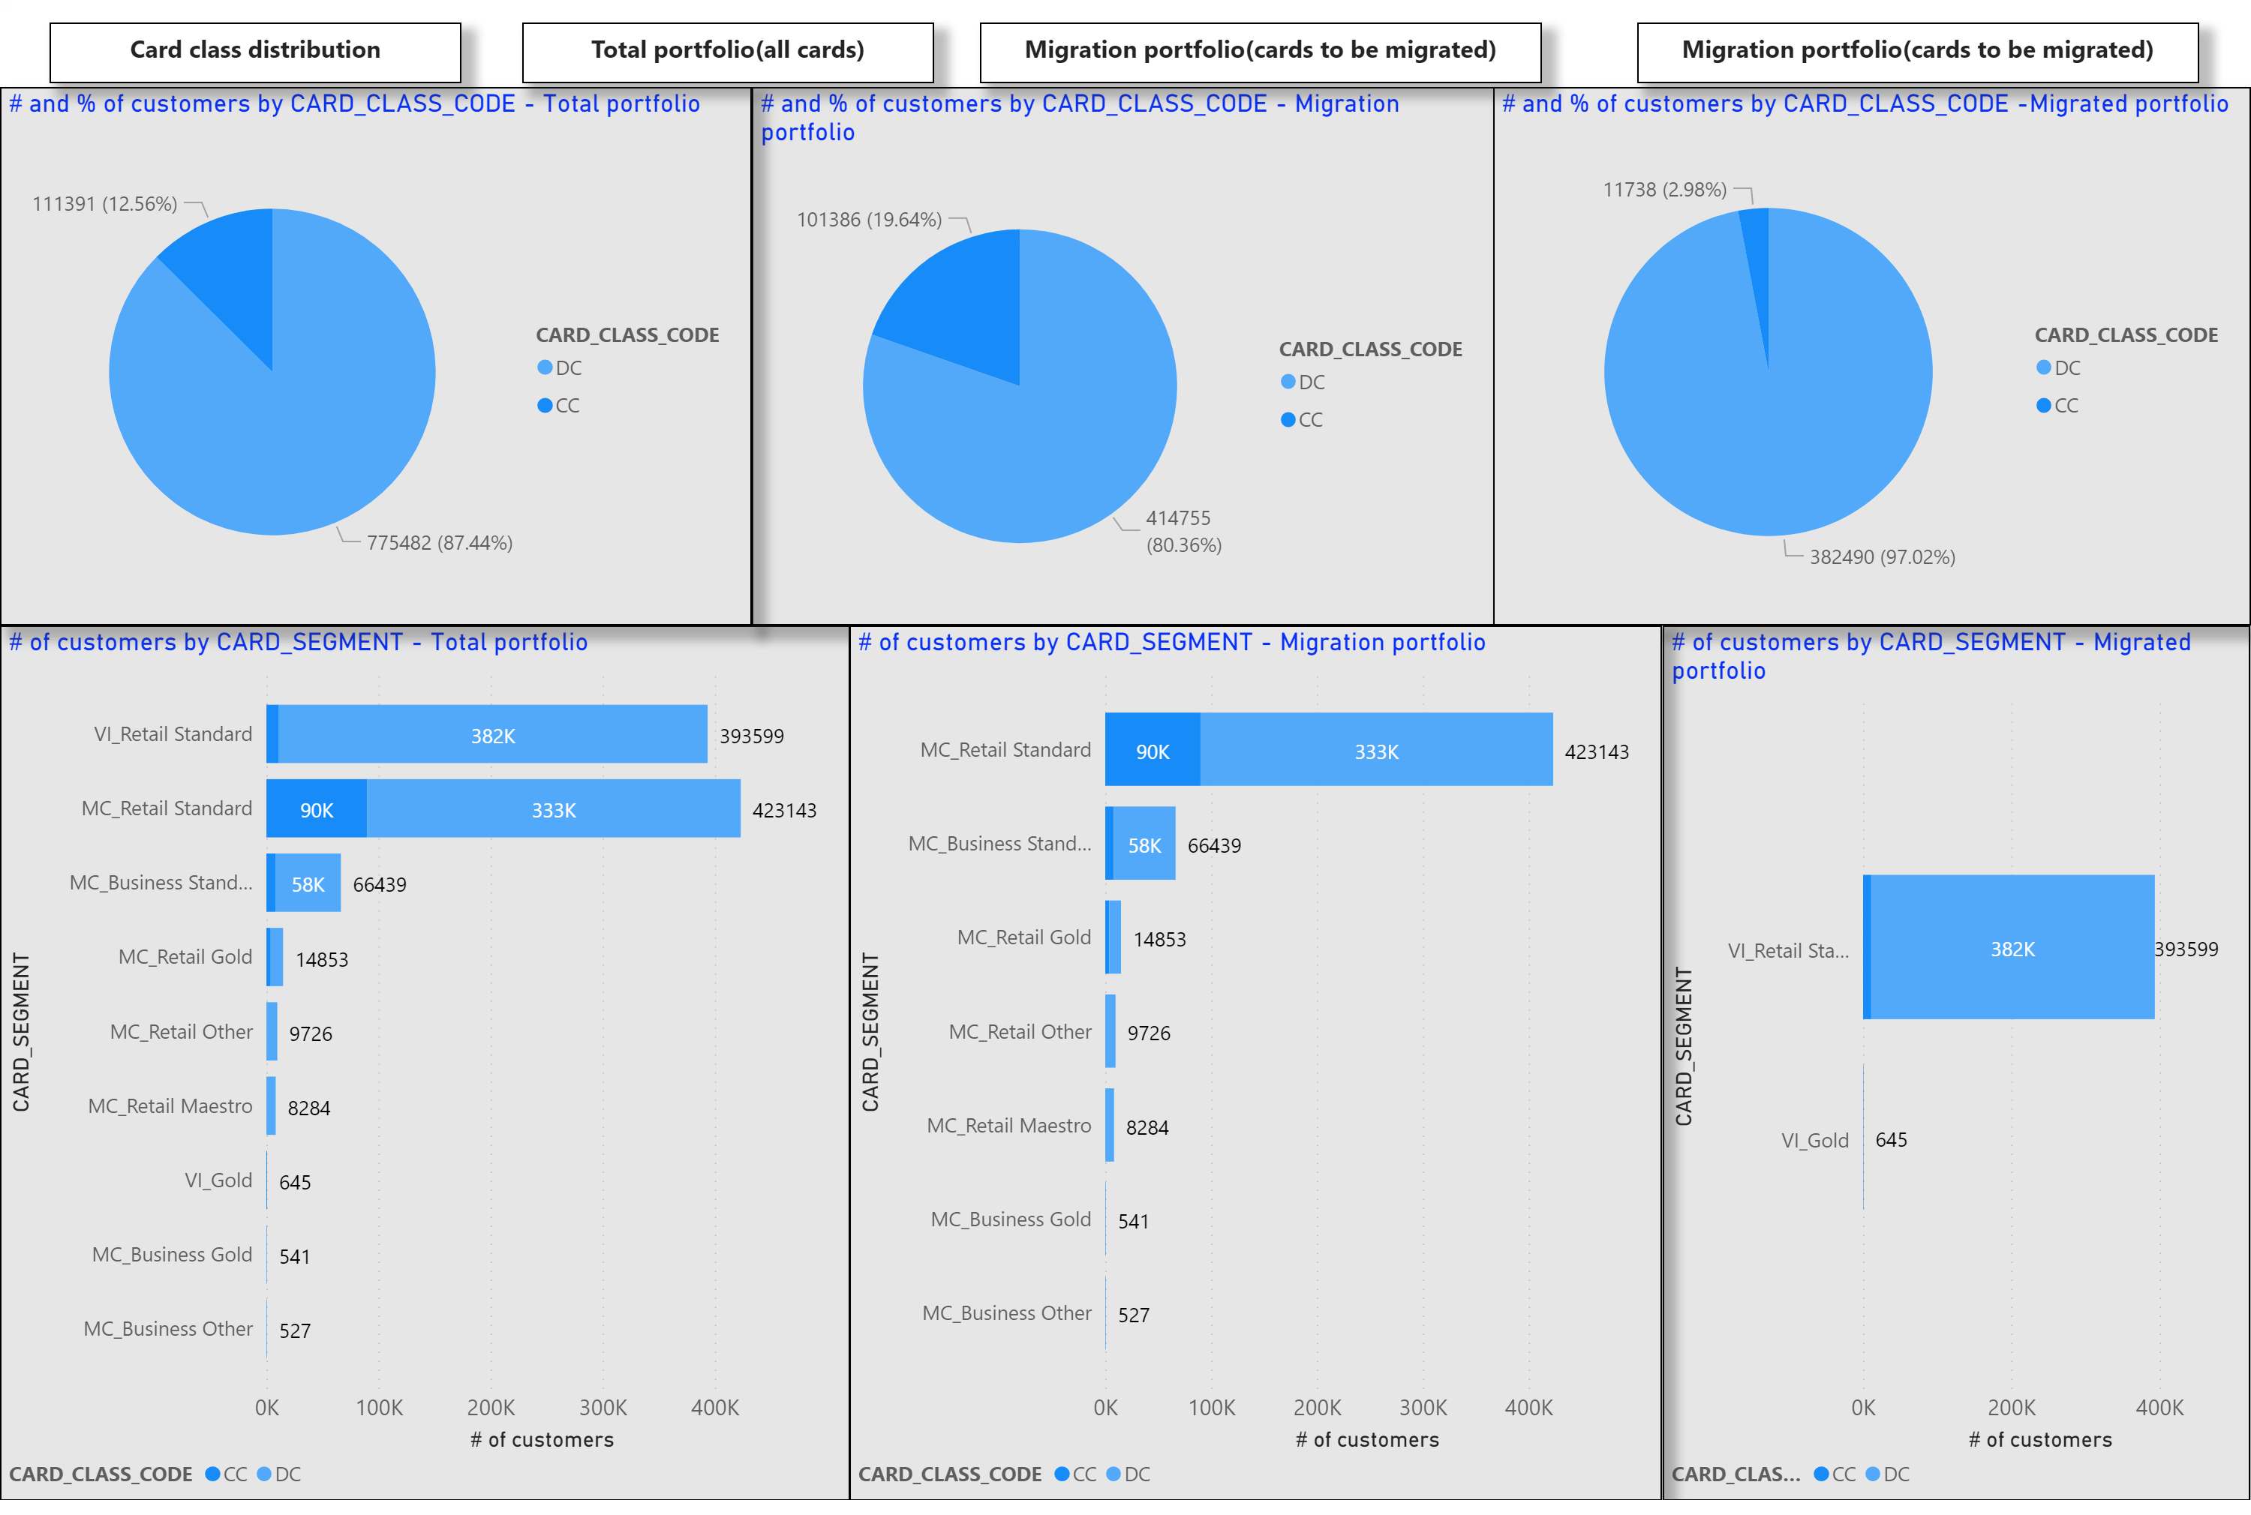
Card class
Notes:
textbox
No alt text provided.
textbox
No alt text provided.
textbox
No alt text provided.
textbox
No alt text provided.
# of customers by CARD_SEGMENT - Total portfolio
No alt text provided.
# of customers by CARD_SEGMENT - Migrated portfolio
No alt text provided.
# and % of customers by CARD_CLASS_CODE - Migration portfolio
No alt text provided.
# and % of customers by CARD_CLASS_CODE -Migrated portfolio
No alt text provided.
# and % of customers by CARD_CLASS_CODE - Total portfolio
No alt text provided.
# of customers by CARD_SEGMENT - Migration portfolio
No alt text provided.

Slide 7
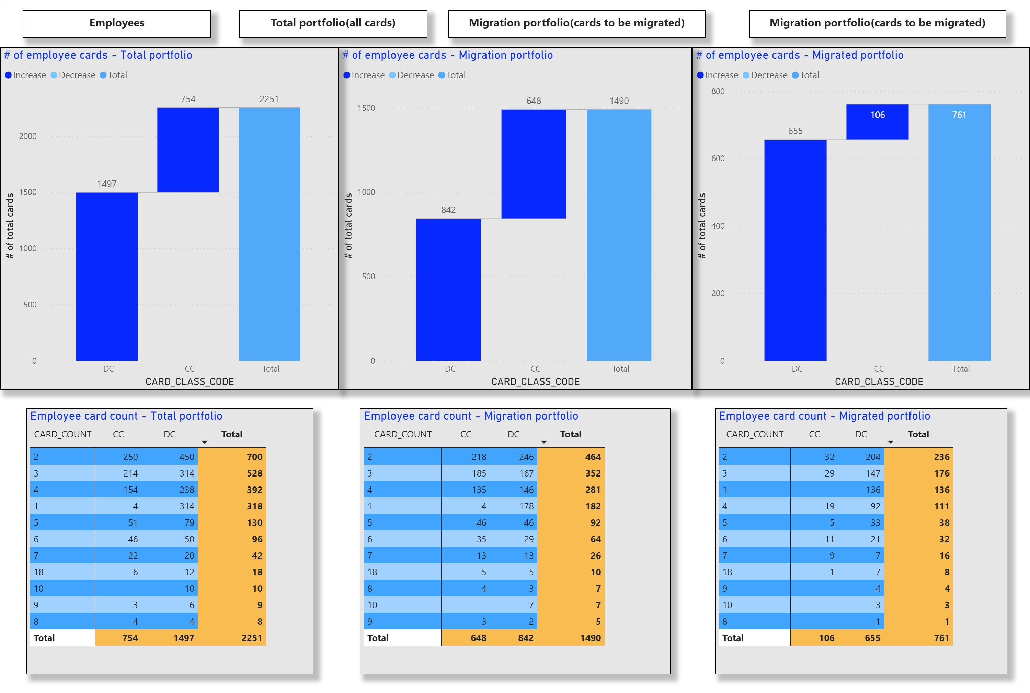
Employees
Notes:
textbox
No alt text provided.
textbox
No alt text provided.
textbox
No alt text provided.
textbox
No alt text provided.
# of employee cards - Migrated portfolio
No alt text provided.
# of employee cards - Migration portfolio
No alt text provided.
Employee card count - Migrated portfolio
No alt text provided.
Employee card count - Migration portfolio
No alt text provided.
# of employee cards - Total portfolio
No alt text provided.
Employee card count - Total portfolio
No alt text provided.

Slide 8
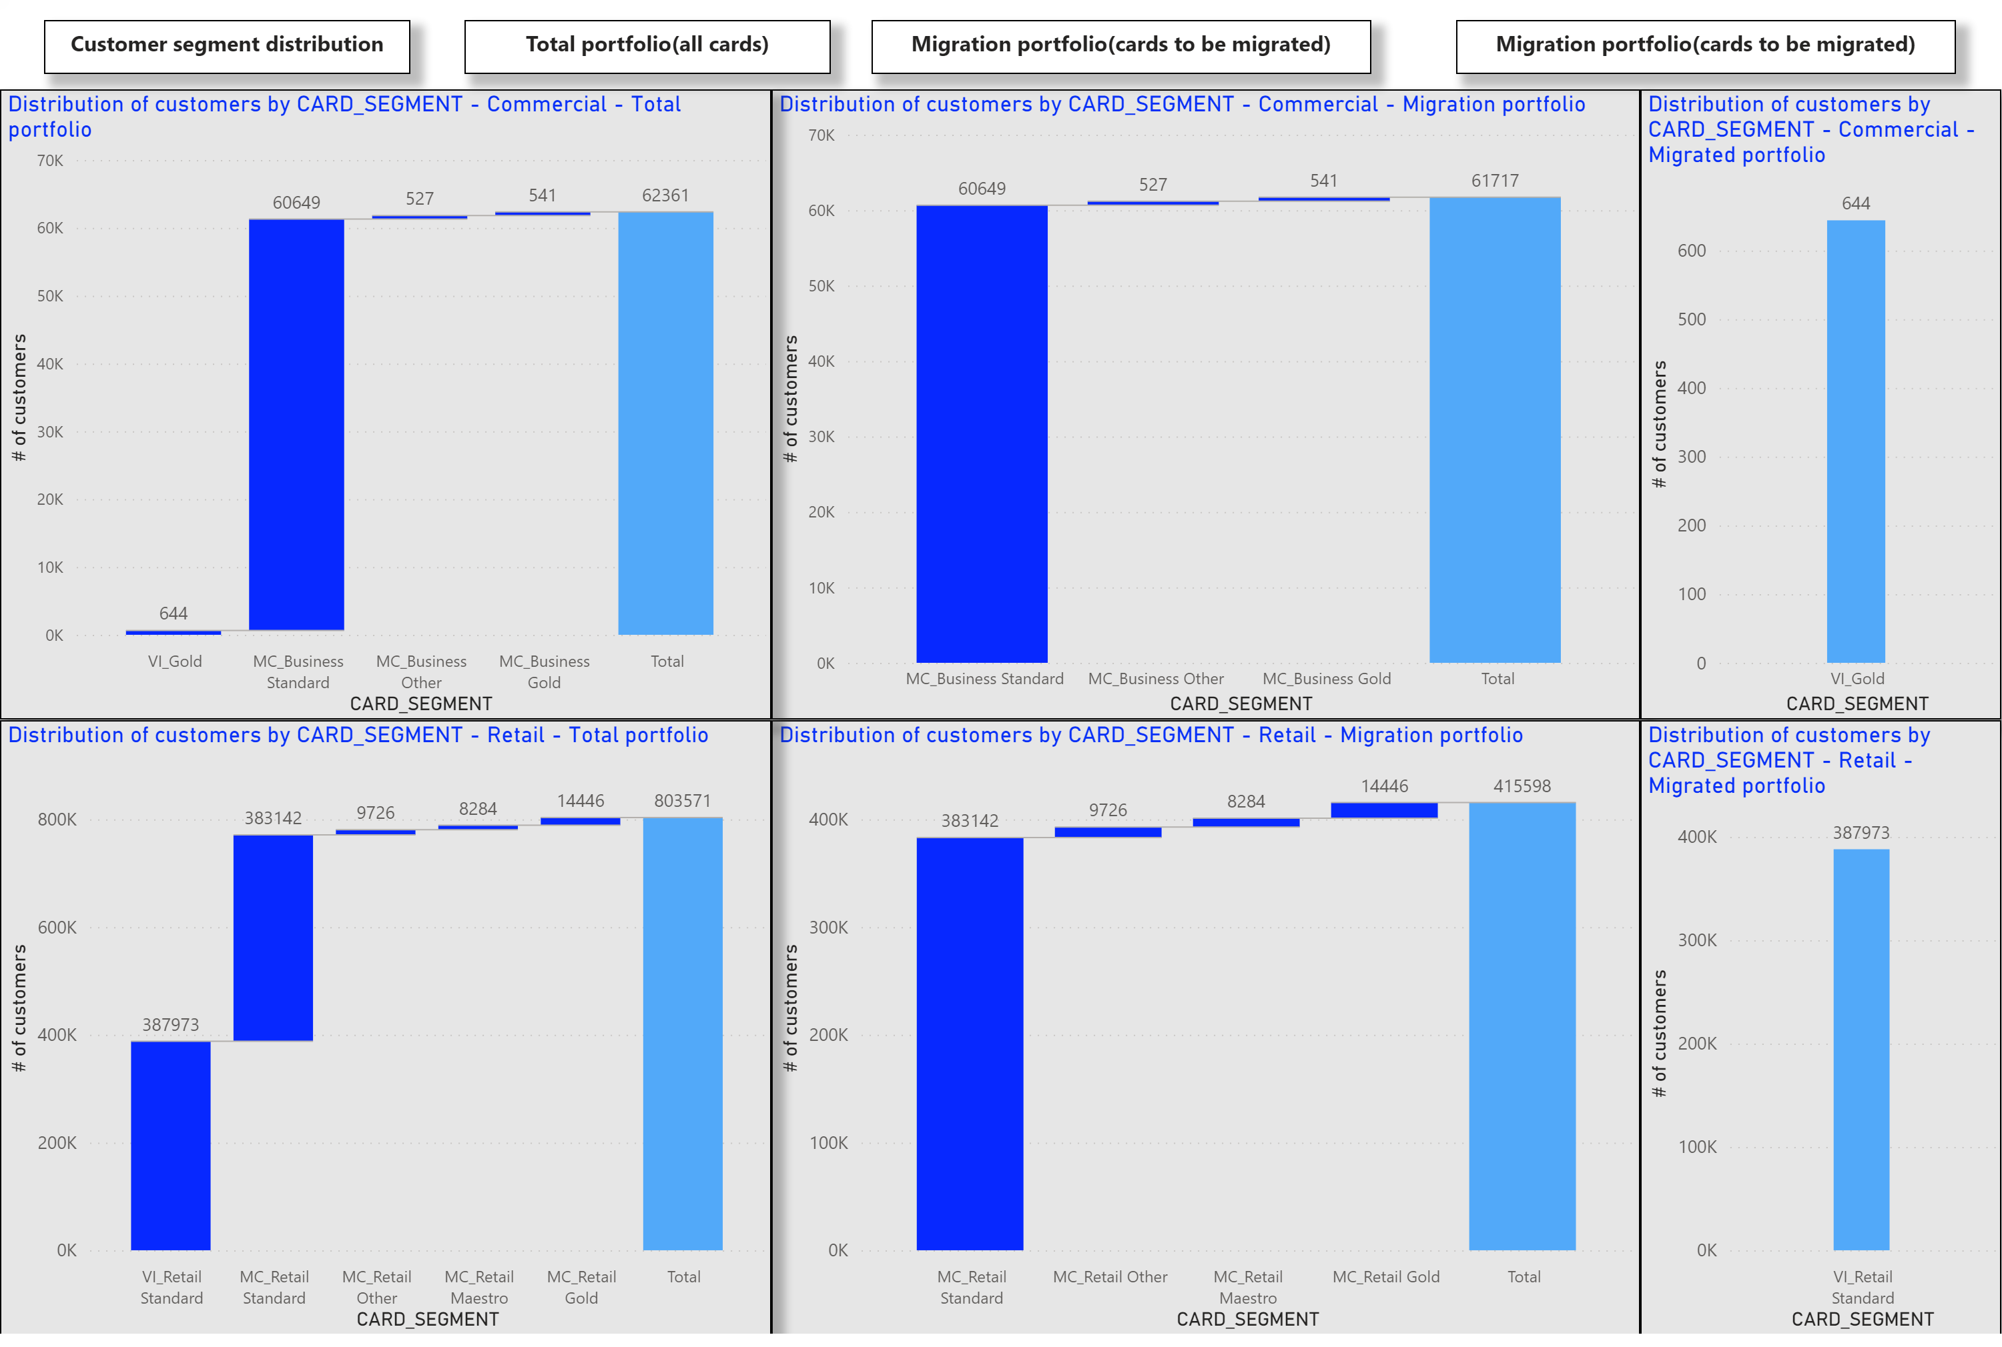
Customer segment
Notes:
textbox
No alt text provided.
textbox
No alt text provided.
textbox
No alt text provided.
textbox
No alt text provided.
Distribution of customers by CARD_SEGMENT - Commercial - Migration portfolio
No alt text provided.
Distribution of customers by CARD_SEGMENT - Retail - Migration portfolio
No alt text provided.
Distribution of customers by CARD_SEGMENT - Commercial - Migrated portfolio
No alt text provided.
Distribution of customers by CARD_SEGMENT - Retail - Migrated portfolio
No alt text provided.
Distribution of customers by CARD_SEGMENT - Commercial - Total portfolio
No alt text provided.
Distribution of customers by CARD_SEGMENT - Retail - Total portfolio
No alt text provided.

Slide 9
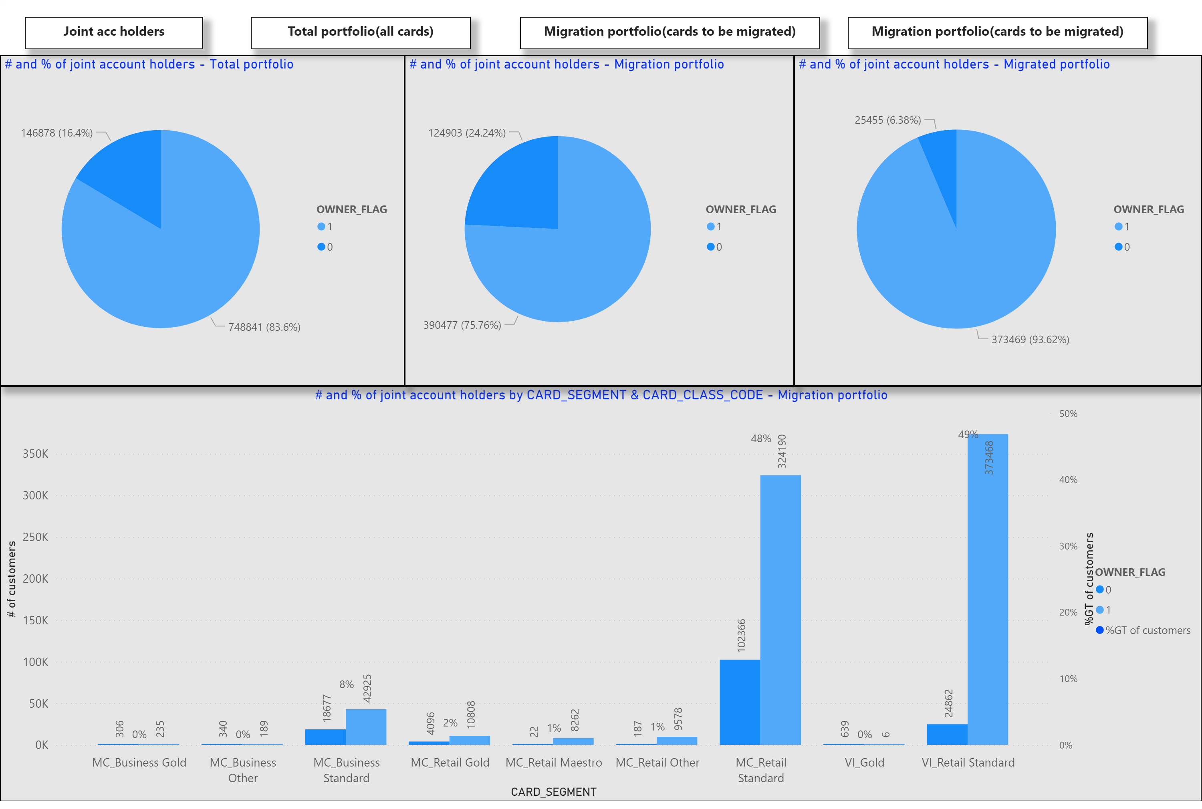
Joint acc
Notes:
textbox
No alt text provided.
textbox
No alt text provided.
textbox
No alt text provided.
textbox
No alt text provided.
# and % of joint account holders by CARD_SEGMENT & CARD_CLASS_CODE - Migration portfolio
No alt text provided.
# and % of joint account holders - Total portfolio
No alt text provided.
# and % of joint account holders - Migration portfolio
No alt text provided.
# and % of joint account holders - Migrated portfolio
No alt text provided.

Slide 10
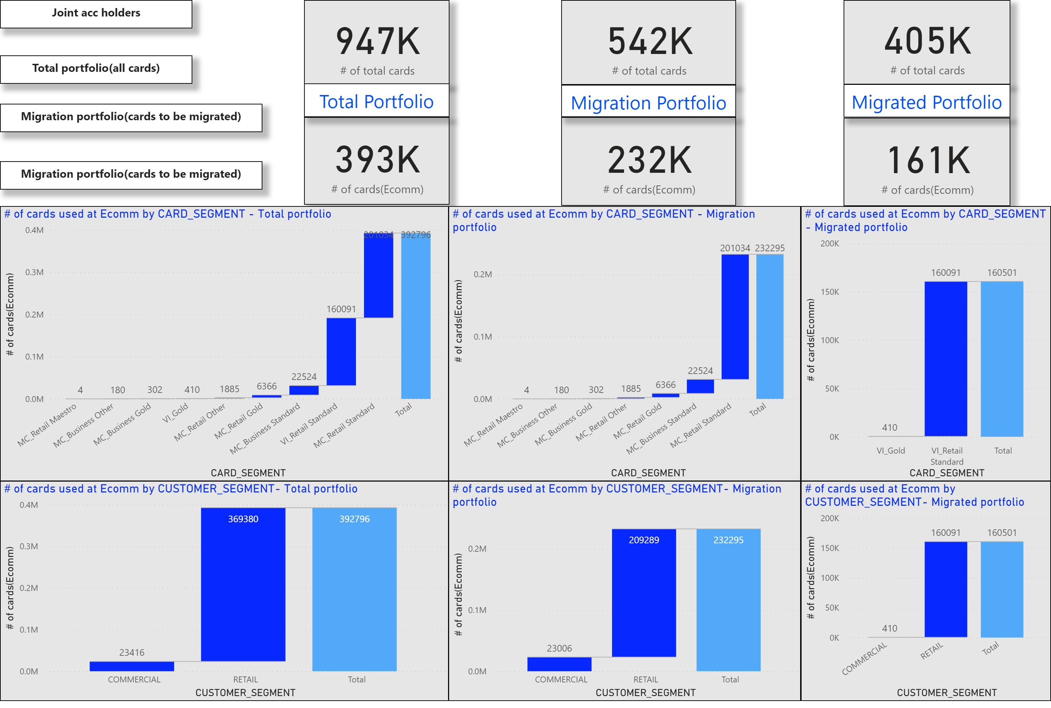
Ecomm
Notes:
textbox
No alt text provided.
textbox
No alt text provided.
textbox
No alt text provided.
textbox
No alt text provided.
card
No alt text provided.
card
No alt text provided.
textbox
No alt text provided.
card
No alt text provided.
card
No alt text provided.
textbox
No alt text provided.
card
No alt text provided.
card
No alt text provided.
textbox
No alt text provided.
# of cards used at Ecomm by CARD_SEGMENT - Total portfolio
No alt text provided.
# of cards used at Ecomm by CARD_SEGMENT - Migration portfolio
No alt text provided.
# of cards used at Ecomm by CARD_SEGMENT - Migrated portfolio
No alt text provided.
# of cards used at Ecomm by CUSTOMER_SEGMENT- Total portfolio
No alt text provided.
# of cards used at Ecomm by CUSTOMER_SEGMENT- Migration portfolio
No alt text provided.
# of cards used at Ecomm by CUSTOMER_SEGMENT- Migrated portfolio
No alt text provided.

Slide 11
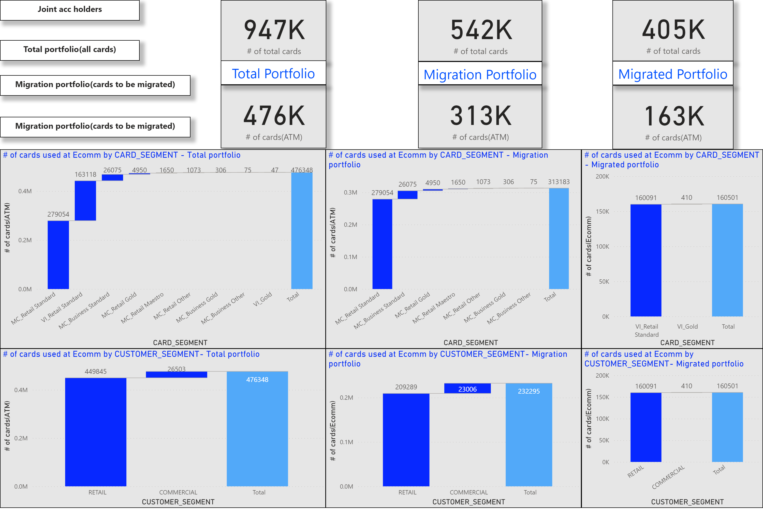
ATM
Notes:
textbox
No alt text provided.
textbox
No alt text provided.
textbox
No alt text provided.
textbox
No alt text provided.
card
No alt text provided.
card
No alt text provided.
textbox
No alt text provided.
card
No alt text provided.
card
No alt text provided.
textbox
No alt text provided.
card
No alt text provided.
card
No alt text provided.
textbox
No alt text provided.
# of cards used at Ecomm by CARD_SEGMENT - Total portfolio
No alt text provided.
# of cards used at Ecomm by CARD_SEGMENT - Migration portfolio
No alt text provided.
# of cards used at Ecomm by CARD_SEGMENT - Migrated portfolio
No alt text provided.
# of cards used at Ecomm by CUSTOMER_SEGMENT- Total portfolio
No alt text provided.
# of cards used at Ecomm by CUSTOMER_SEGMENT- Migration portfolio
No alt text provided.
# of cards used at Ecomm by CUSTOMER_SEGMENT- Migrated portfolio
No alt text provided.

